Slide 1
Lecture 5
Sidra Khatoon
SEB-312

Slide 2
InkWell Widget
An InkWell in Flutter is a widget that effectively simulates material design ink splash on any widget for visual interactivity.
When a user taps on the Inkwell widget, ink splash, or ripple effect is displayed.
It gives an graphic visual feedback to emphasize the user’s point of contact.

Slide 3
Features of Flutter InkWell
InkWell class in Flutter is closely tied to the Material widget and often used alongside it. Here are a few essential characteristics:
Inkwell can encase various widgets
Inherits attributes from GestureDetector
Provides ink splash and ripple effects
Displays an highlight color as per user desire
It has different splash and highlight color configurations
Reacts to different touch events (user clicks, long press, etc.),
Able to modify the splash color, radius, and border radius.

Slide 4
When to Use InkWell in Flutter?
You'll find Inkwell is especially beneficial when building Flutter applications that need a material design aesthetic with interactive ink reactions.
Use Inkwell anytime a user needs to interact with widgets on the screen, capturing their taps and long presses.

Slide 5
ScrollView Widget
For displaying more content than can fit on the screen
A ScrollView widget in Flutter allows you to create complex scrolling effects and layouts
Users scroll within the content by making swiping gesture
You can use it to create scrollable views with multiple slivers, each having its own behavior
A silver is a portion of scrollable area that you can define to behave in special way

Slide 6
ListView Class in Flutter
In Flutter, ListView is a scrollable list of widgets arranged linearly. It displays its children one after another in the scroll direction i.e., vertical or horizontal.
There are different types of ListViews :
ListView
ListView.builder
ListView.separated
ListView.custom

Slide 7
ListView()
This is the default constructor of the ListView class
A ListView simply takes a list of widgets and makes it scrollable
It is appropriate for small number if children
Use it to display a static list of children whose count does not change

Slide 8
ListView.builder()
It takes an IndexedWidgetBuilder, which builds the children on demand
It is basically used for the list views with large number of children
The builder() constructor constructs a repeating list of widgets
The constructor takes two main parameters:
An itemCount for the number of repetitions for the widget to be constructed (not compulsory).
An itemBuilder for constructing the widget which will be generated ‘itemCount‘ times (compulsory).

Slide 9
ListView.separated ()
It is used to generates the list like other but also here we can specify the separated widgets between each item
It is appropriate for list views with a fixed number of children

Slide 10
Flutter ListTile
The ListTile widget in Flutter is a UI element that displays related information
The ListTile widget is used to populate a ListView in Flutter. It contains a title as well as leading or trailing icons
It follows the List specification from Material Design. A typical ListTile is divided into three sections; Start, Center, and End
The Start section contains the leading widget; the Center section includes the title and subtitle, and the End section contains the trailing widget
It is mainly used to populate the scrollable views such as ListView, Column, and Row

Slide 11
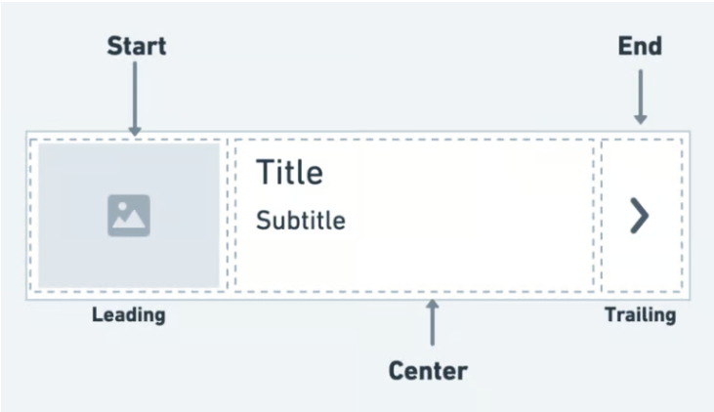
Flutter ListTile

Slide 12
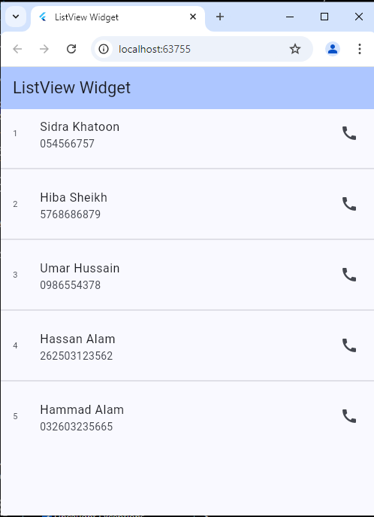
Example of ListTile

Slide 13
ListTile Variation
There are also other types of ListTile that exist that allow you to perform a specific action on it.
These are:
CheckboxListTile
RadioListTile
SwitchListTile

Slide 14
CheckboxListTile
The CheckboxListTile widget is a combination of ListTile and Checkbox widgets.
We can use this widget to mark any item as complete — for example; to-do items. By default, the checkbox is displayed on the right side of the ListTile (for left-to-right language).

Slide 15
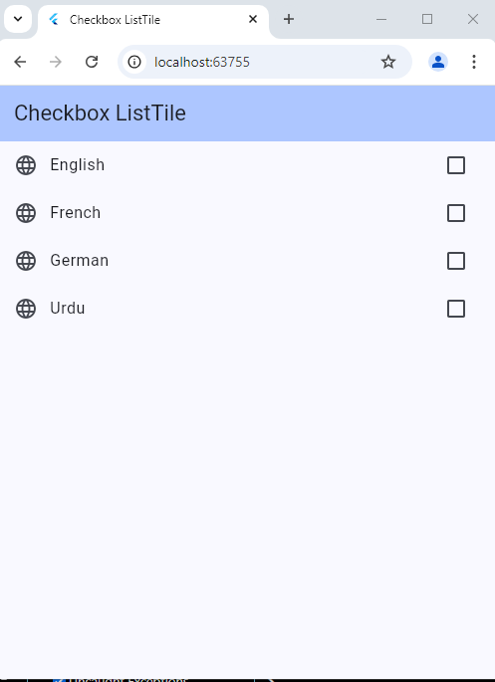

Slide 16
RadioListTile
The RadioListTile widget is a combination of ListTile and RadioButton widgets — this widget is used to select a single option from a list of items.

Slide 17
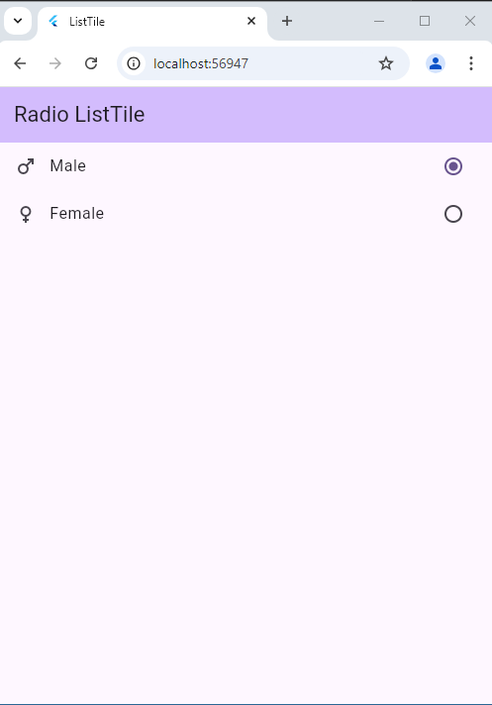

Slide 18
SwitchListTile
The SwitchListTile widget is a combination of the ListTile and Switch widgets.
We can use this widget to build the UI interaction that allows users to switch on or off app settings.

Slide 19
